Slide 1

Design Thinking
& Innovation
Presented by
Hemanth - 23KD1A0220
Sirisha - 23KD1A0244
Tejash - 23KD1A0248
Manasa - 24KD5A0206
UNDER THE GUIDANCE OF:
Mr. B. Ram VaraPrasad,(Ph.D)
Assistant Professor, Department Of EEE,
LIET (A).

Slide 2


Leave Pilot: Streamlining Leave Management for Educational Institutions
Leave Pilot is a revolutionary digital solution designed to simplify the leave management process for schools and colleges. It enhances communication between students, faculty, and administration by streamlining leave applications, approvals, and tracking in one seamless platform.
This presentation unfolds the journey of Leave Pilot from storyboarding to prototype, demonstrating its intuitive workflows and robust features tailored for educational institutions looking to modernize their leave processes.

Slide 3
Understanding the Leave Pilot Project
What is Design Thinking & Innovation
Problem Statement
Empathy
Define
Ideate
Storyboarding
Prototype
Prototype Explanation
Conclusion
This presentation guides you through the core concepts underlying our Leave Pilot solution, from the methodology of design thinking to concrete prototypes. Each stage is tailored to address challenges in current leave management systems and drive innovative improvements.

Slide 4
What is Design Thinking & Innovation?
Definition
Phases
Design Thinking is a human-centered, iterative problem-solving approach focused on deeply understanding user needs and delivering innovative solutions.
Empathize: Gain user insights
Define: Identify core problem
Ideate: Brainstorm creative ideas
Prototype: Build actionable models
Test: Refine through feedback

Slide 5

Problem Statement: Challenges in Leave Management
Outdated Process
Communication Gaps
Current leave applications rely heavily on manual, paper-based submission, lacking automation or digital tracking.
Students remain uninformed of leave status; faculty struggle to track approvals efficiently.
Administrative Burden
Admins face challenges maintaining records accurately and producing timely consolidated reports.

Slide 6
Empathy Analysis: The 5 Whys
1
Why is the leave process ineffective?
2
Why is it manual?
3
Why no digital system?
No digital solution has been implemented yet
Lack of initiative towards automation
Because it is manual and lacks transparency
4
Why the delay in implementation?
5
Why is student experience deprioritized?
Administrative inertia hampers progress
Low prioritization of user-centric solutions

Slide 7
Empathy: Understanding Key Personas
Sahith (Student)
Mohith (Student)
Daniel (Student)
Needs timely leave approvals for medical reasons but lacks clarity on status updates.
Manages numerous leave requests manually, often overwhelmed by paper workload and tracking issues.
Responsible for compiling leave records and generating periodic reports, which is time-consuming and error-prone.

Slide 8

Key Interview Insights
How do students apply for leave?
What challenges do users face?
Primarily through letters or emails, followed by manual follow-ups for approval status.
Lack of transparency about leave status and frequent delays in approval processes.
Administrative difficulties?
Consolidating and maintaining leave data without a centralized digital system is tedious and inefficient.

Slide 9
Empathy Maps & User Touchpoints
User Touchpoints
Pain Points
Submitting leave request letter
Delayed responses
Status notifications on notice board
No notification system
Informal confirmation via word of mouth
Requests often misplaced
The current experience involves submitting and waiting with no updates, leading to repeated office visits for status inquiries.

Slide 10

Define: Point of View Statement
Students and faculty require a centralized, digital platform to manage leave applications efficiently. This system should ensure transparency in tracking and approvals to mitigate confusion and avoid unnecessary delays caused by the outdated manual process.

Slide 11

Ideation: Generating Innovative Solutions
Digital Leave Application Portal
Enables students to apply and track leave requests online seamlessly.
Automated Status Notifications
Real-time updates via email and mobile app ensure users remain informed.
Faculty Approval Panel
Facilitates efficient management and approval of requests by faculty online.
Admin Analytics Dashboard
Provides comprehensive reports and insights for streamlined record-keeping.

Slide 12
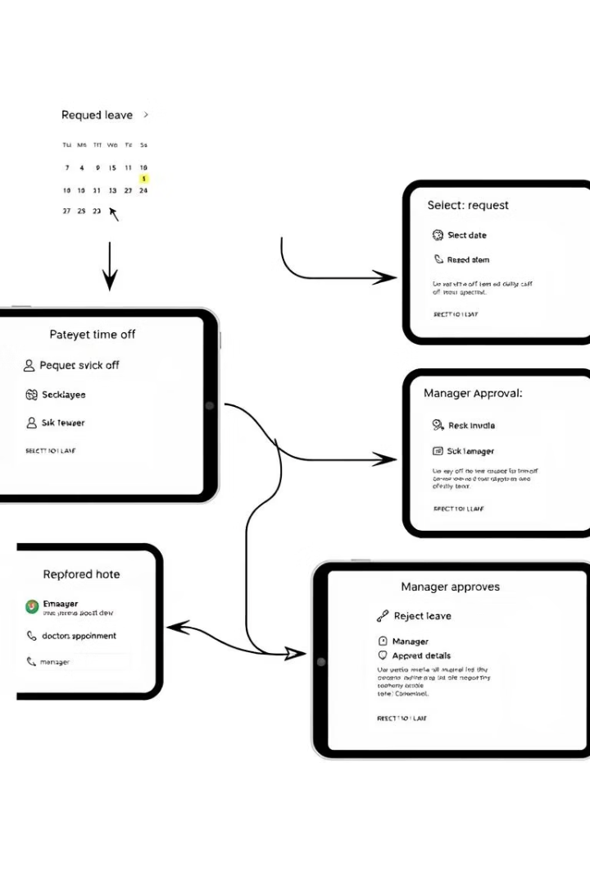
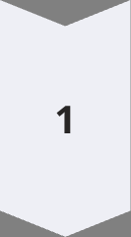
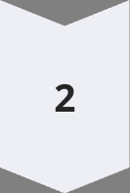
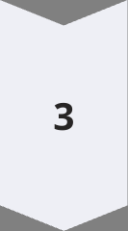
User Journey and Storyboarding
Student Application
The student opens Leave Pilot, selects the leave type and duration, and submits the request with a reason and optional attachment.
Faculty Review
Faculty instantly receive alerts to approve or reject requests via their dashboard, facilitating real-time decisions.
Notifications & Reporting
Students get immediate updates on status changes. The administration accesses automatic reports for efficient record-keeping.

Slide 13
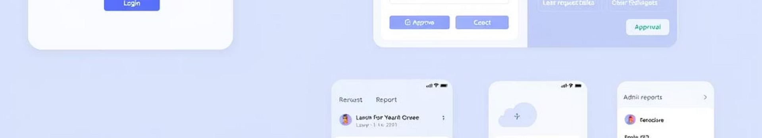
Prototype Highlights
Login/Signup
Leave Request Form
Secure and easy access for students, faculty, and admins with multi-user role management.
Simple, responsive design allowing students to select leave type, dates, and attach documents.
Faculty Approval Panel
Reports View
One-click approval or rejection with real-time notifications to applicants.
Admin dashboard consolidates leave data for analysis and compliance tracking.

Slide 14
How Leave Pilot Works: Features & Benefits
Key Features
Benefits
Secure logins with role-based access
Eliminates paperwork and manual errors
Mobile and PC responsive interface
Accelerates approval workflows
Real-time leave status updates
Enhances communication between stakeholders
Complete transparent history tracking
Facilitates detailed reporting and analytics
Future upgrades include AI-powered chatbots for FAQs, multi-language support, and automated reminders to ensure timely faculty response to pending requests.

Slide 15

Questions & Next Steps
Contact Information
We Value Your Feedback
Email: hemanth.kumarhk100@
gmail.com
Looking forward to your questions, suggestions, and collaboration opportunities to further enhance Leave Pilot.
Phone: +91-7075915507
Next Steps
Engage in pilot programs, integrate with institutional systems, and customize the solution to specific educational needs.

Slide 16
Thank You !

